Slide 1
Webhook Notifier Event Processing Solution
Scalabity - Realiability - Fairness

Slide 2
Introduction to Webhook Notifier Event Processing
The Webhook Notifier solution is designed to handle an impressive 1 billion events per month. It emphasizes scalability, reliability, and fairness, making it a robust choice for event processing.
Architecture Overview
Event Processing Flow
Scalability & Reliability & Fairness
Infrastructure
Conclusion and Q&A
Future Steps and Enhancement
Monitoring and Metrics
Testing and Benchmark

Slide 3
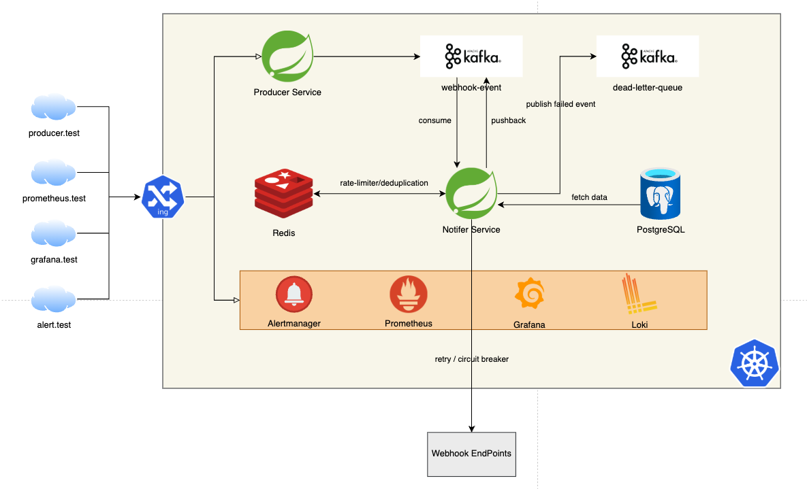
Architecture Overview

Slide 4
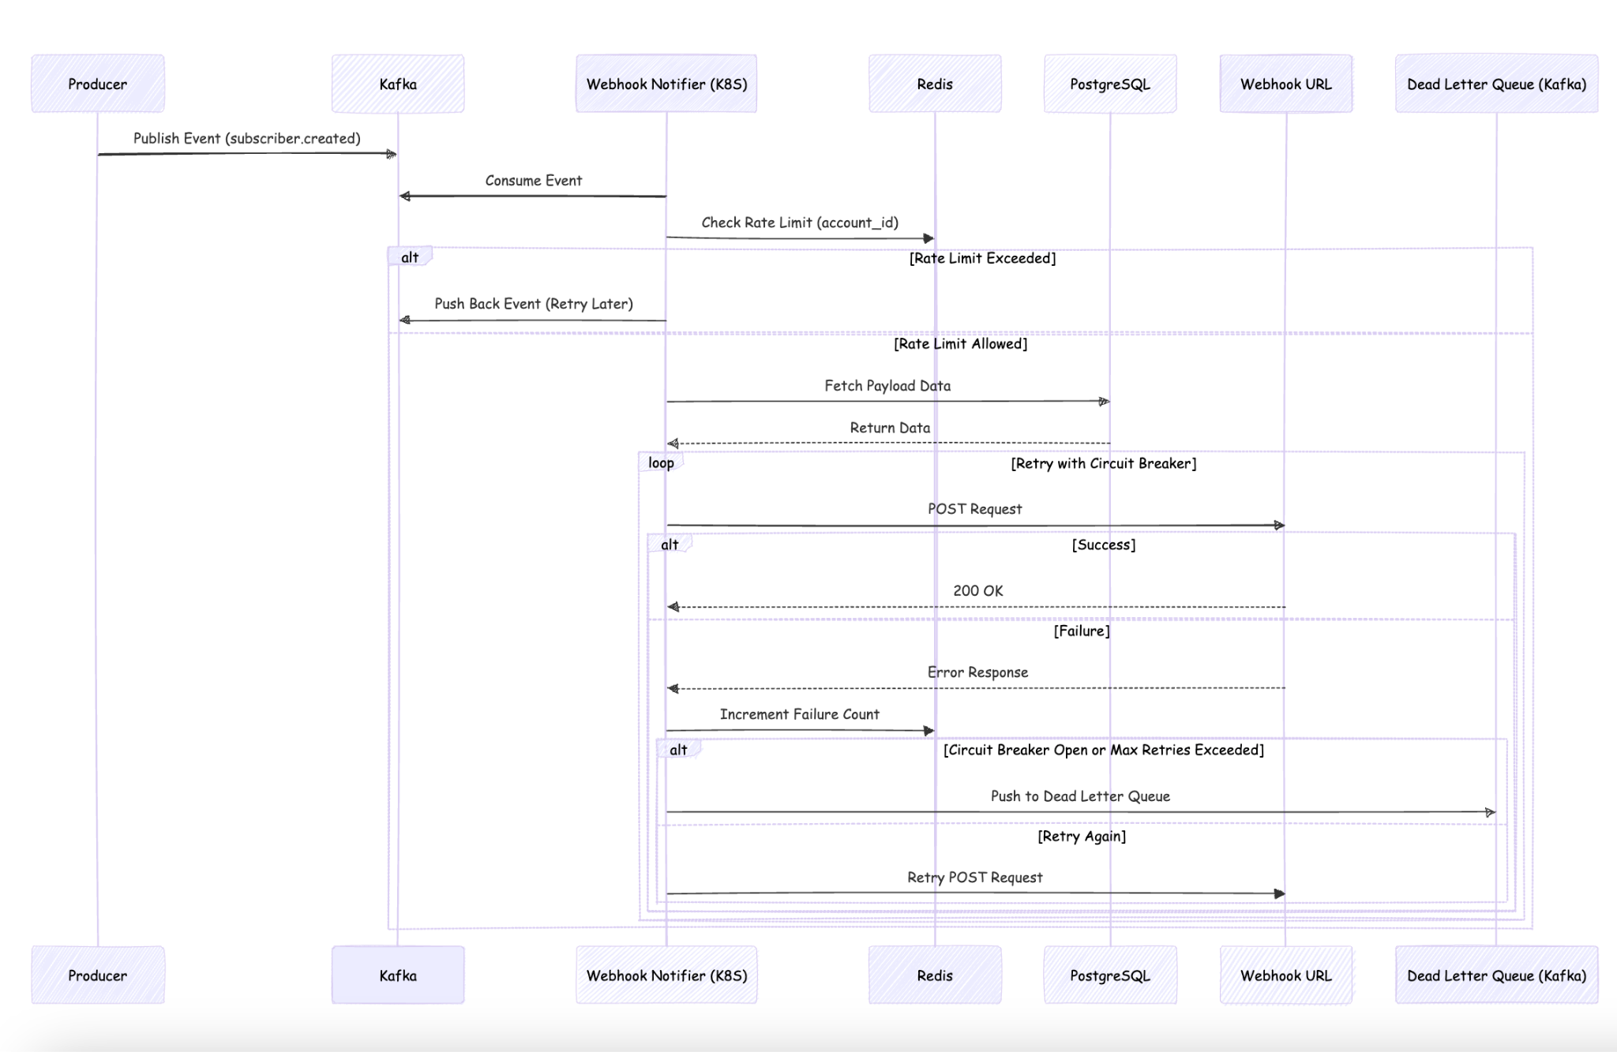
Event Processing Flow

Slide 5

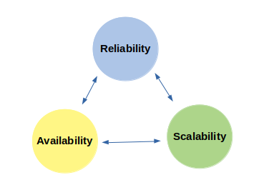
Scalability & Reliability
Fairness
Retries: For failed webhook calls.
Circuit Breaker: Prevent cascading failures.
Dead Letter Queue: For handling failures effectively.
Message Broker: Prevent lost event with manual ack in Kafka Consumer.
Deduplication: Managed by Redis to ensure unique events.
Rate Limiting: Events are re-queued if exceed limit.

Slide 6

Infrastructure
Our infrastructure is built on:
Kubernetes with Helm and Docker Hub: For deployment.
Components: Producer, Consumer, Kafka, Redis, PostgreSQL.
Monitoring Tools: Loki, Grafana, Prometheus.
Configuration: Kafka throughput, Redis latency, and Kubernetes auto-scaling.

Slide 7
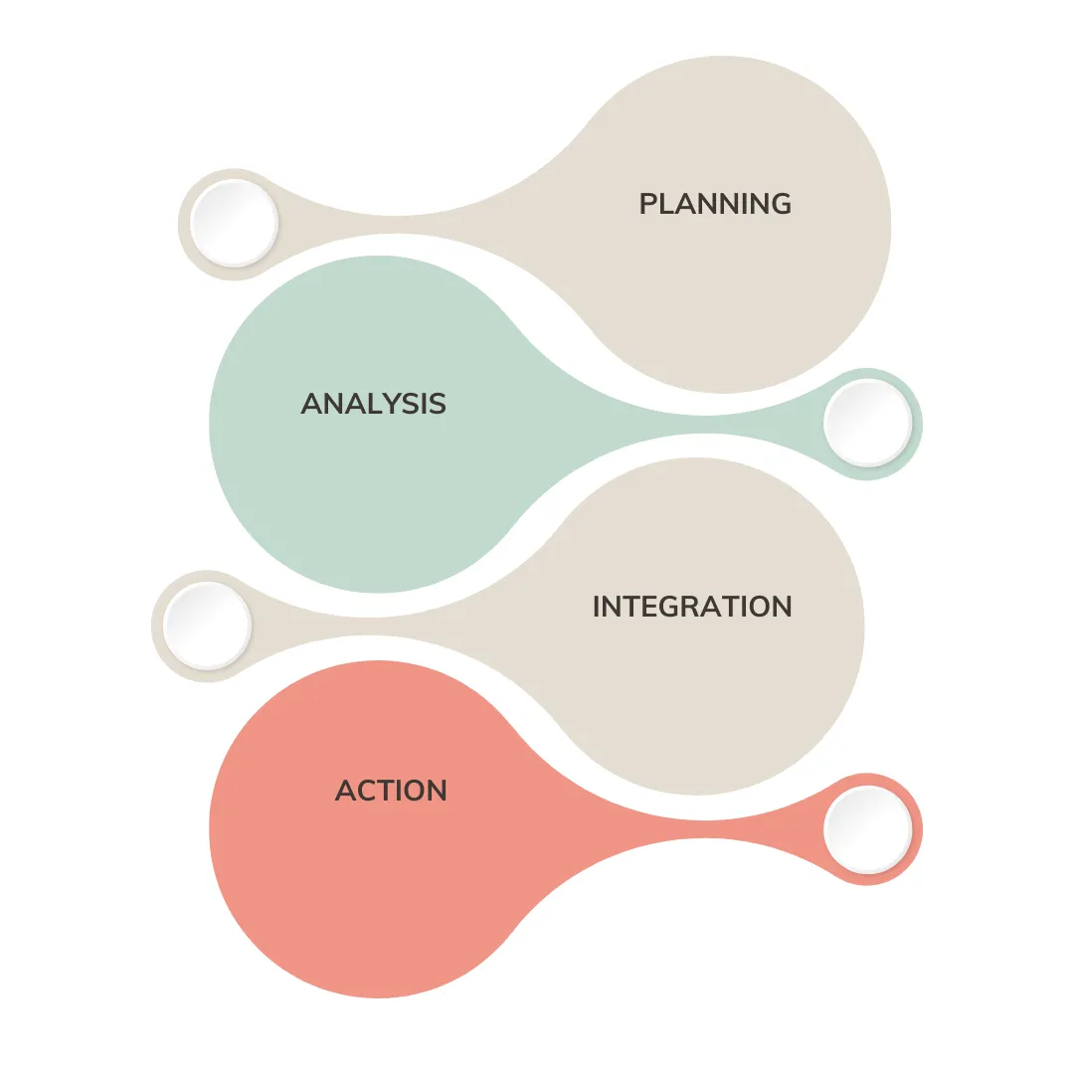
Testing and Benchmark
Unit Tests: Provide partial coverage.
Test Data: Generated using Python and CSV files.
Performance Testing: Conducted with JMeter, sending 10000 events.
Results: Initial tests are OK, throughput of approximately 70 events/second per an instance (0.25 vCPU, 500 MB Ram).
Target: Achieve 1 billion events per month.

Slide 8
Monitoring and Metrics
kafka.batch.processing.time
webhook.execution/success/failure
circuit.open
kafka.event.count
Key metric for monitoring batch processing time.
Metric for tracking success and failure rates of webhook executions.
Metric indicating when the circuit is open.
Metric for monitoring pod scaling and resource utilization

Slide 9
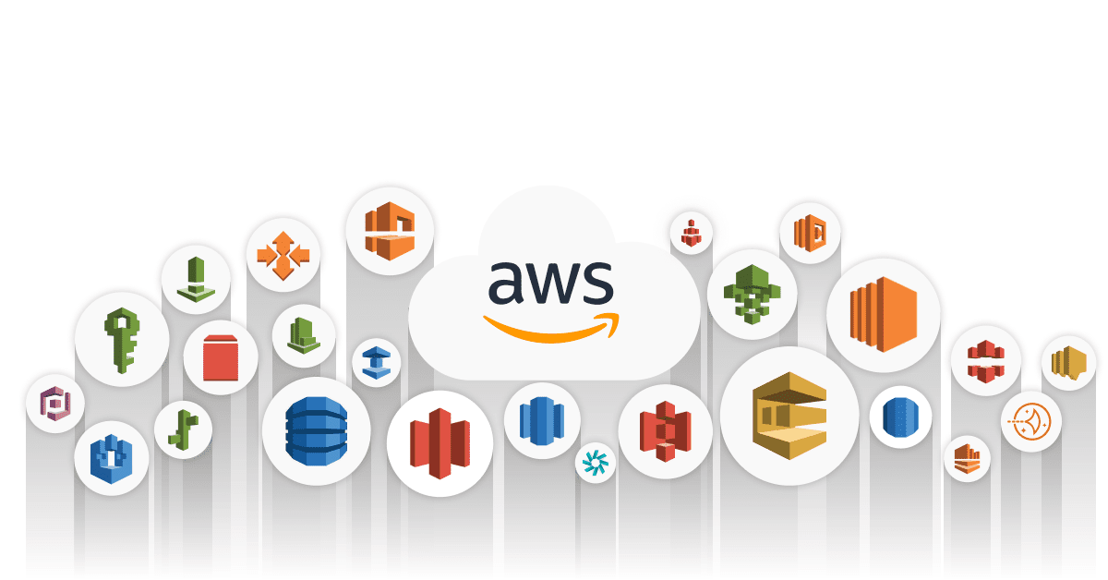
Future Steps and Enhancements
Looking ahead, we plan to:
Deploy on AWS cloud.
Setup CI/CD.
Optimize processing by fine-tuning config.
Handle rate limiter per vendor/account.
Optimize event data fetching.
Add service to DLQ handling.

Slide 10

Conclusion, Demo and Q&A
In summary, the Webhook Notifier is a powerful solution capable of processing 1 billion events per month with a focus on scalability, reliability and fairness. Feel free to ask any questions or discussions to further explore this exciting project!

